Slide 1
SimTraffic
Tommy McLeroy

Slide 2
Contents
Concept
Design
Roads
Lights
Learning
Objective
Future
Demo

Slide 3
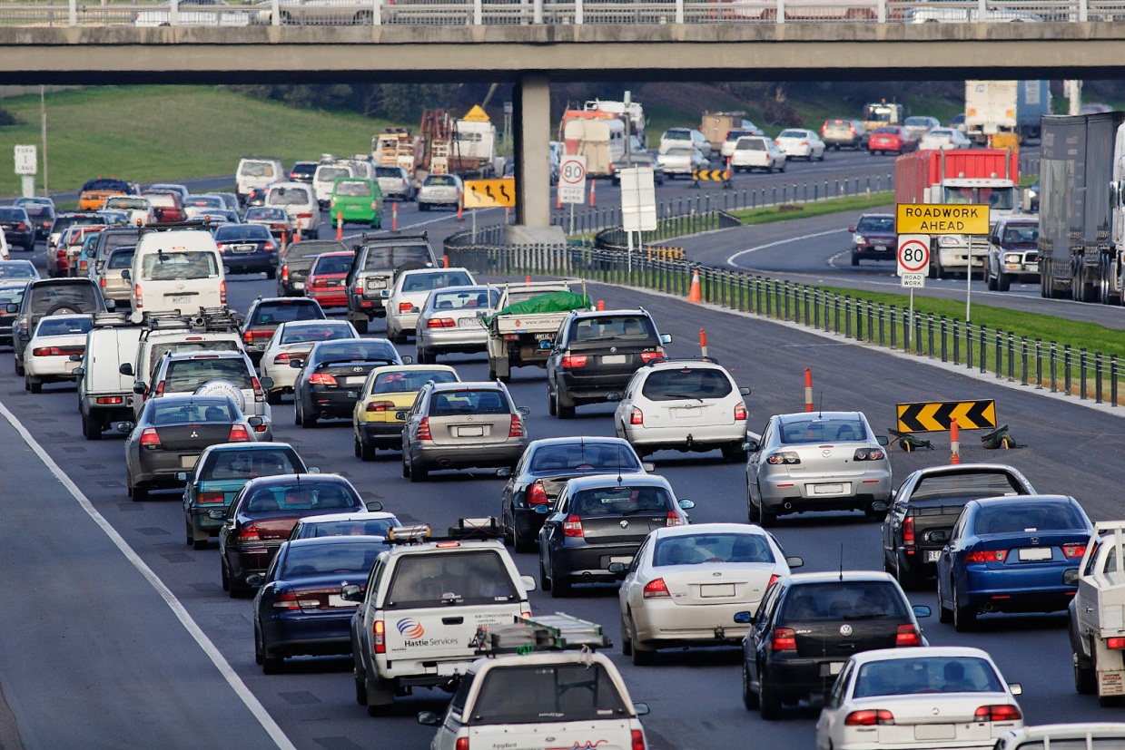
Concept
Modern Solution
Fully Customizable
Dynamically timed lights
Adaptive learning

Slide 4
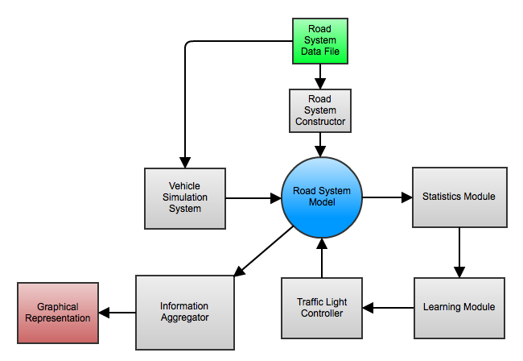
Design

Slide 5
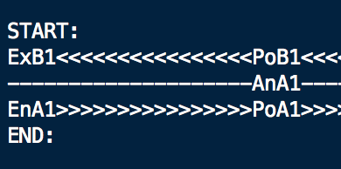
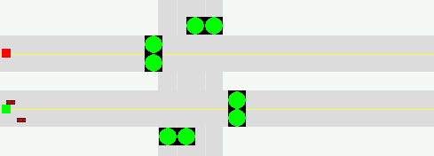
Roads
Input
Output

Slide 6
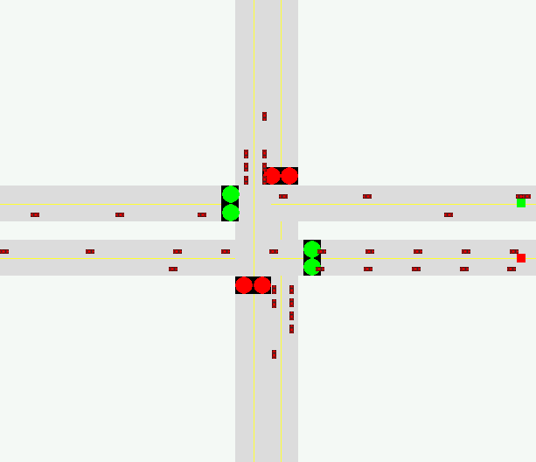
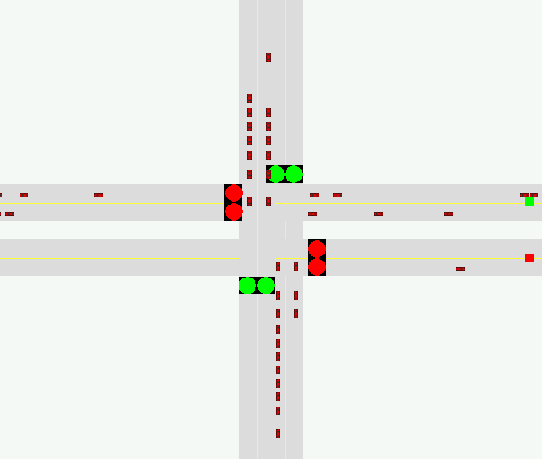
Lights : The Basics
1.
1
2.
1
2
2
4
4
3
3
Even Weight > Odd Weight
Even roads may go
Odd Weight > Even Weight
Odd roads may go

Slide 7
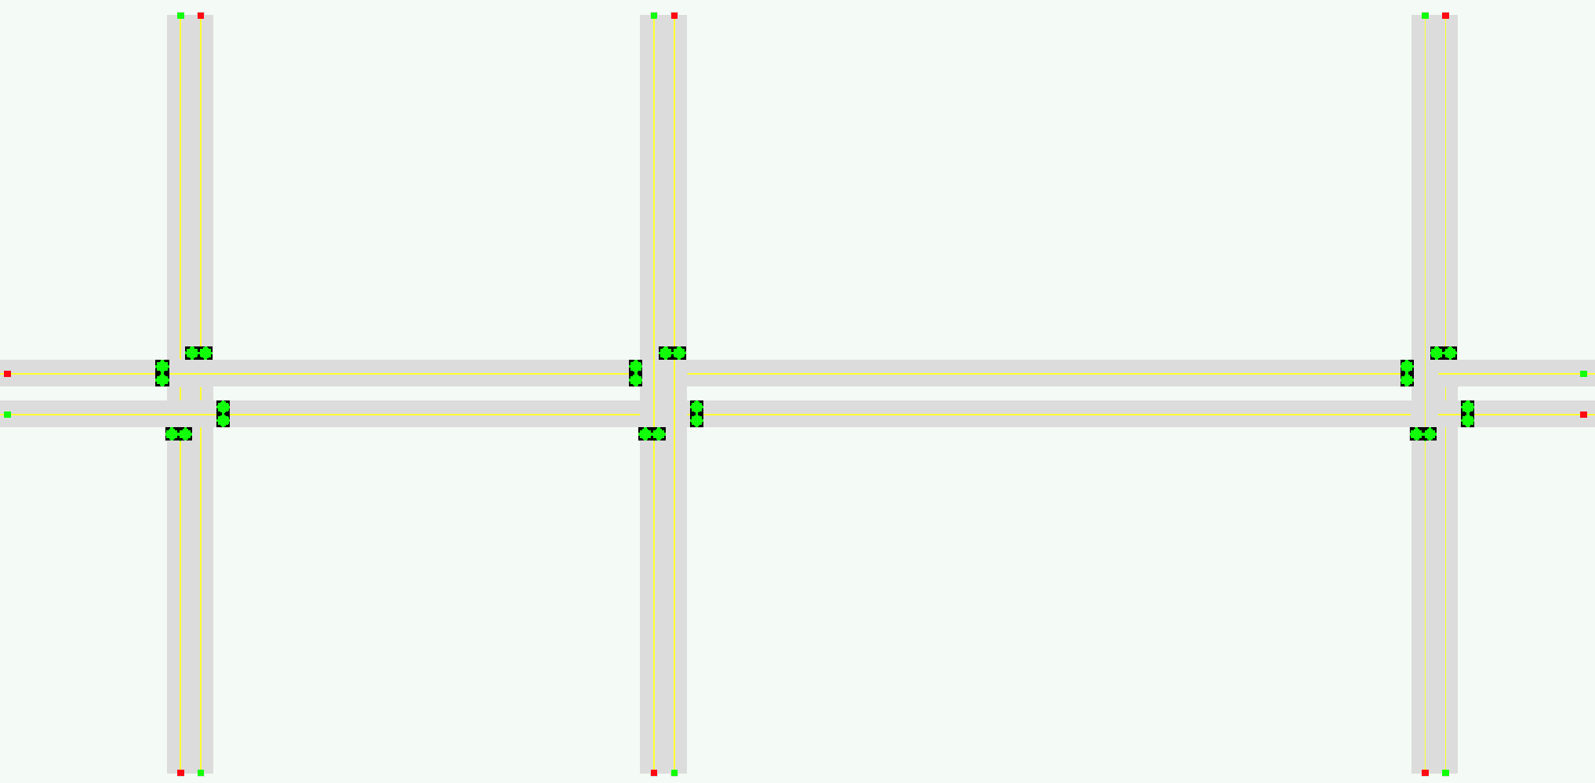
Lights : Token System
5
4
3

Slide 8
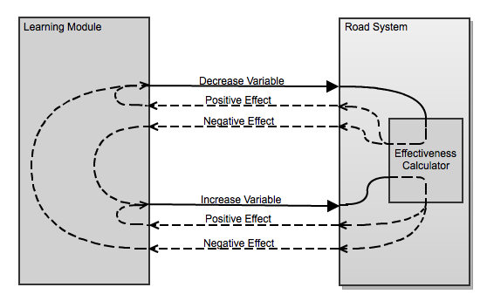
Learning

Slide 9
Objective Function
Avg. Throughput
Avg. Trip Time
Effectiveness Metric =

Slide 10
Future
Graphical Features
Zooming
Hardware Acceleration
Vehicle Simulation Features
Turning
Crashing
Manual Light Timing Options
For Comparison
Statistical Features
Charts, Graphs, etc.

Slide 11
Demo

